Slide 1
Summary of the experiments - 2
Mar – 11 -2020

Slide 2
Contents
Ten fold cross-validation results
Experimental results on the test set
Remarks

Slide 3
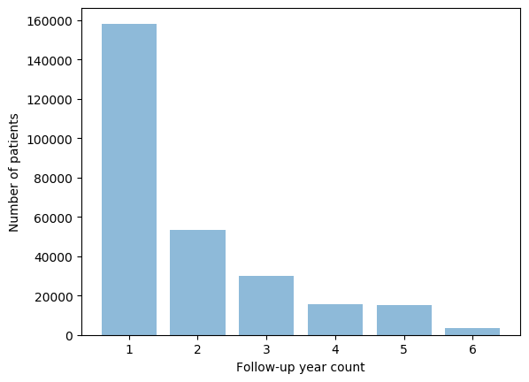
Dataset
This study considers only patients with
at least 2 years of continuous annual medical check-up during the follow-up period
not previously diagnosed with Diabetes, hyperlipidemia, or hypertension
No missing features Instances
The total number of instances after the preprocessing is 169,024
Number of patients: 80,692
Male count: 48,912
Female count: 31,780
The mean age: 41.17 ± 9.95
Region of interest
 | Training set | Testing set
Diabetes | 17,131 | 200
Prediabetes | 17,131 | 200
Normal | 17,131 | 200

Slide 4
1. Cross-validation results
10 Fold Cross-validated scores on 12 features set and 5 features set [traditional features set] are presented
In the experiment, we concatenated n (n=1,2,3,4) years of data to test the performance of the prediction models
12 features set
5 features set

Slide 5
2. Test Set results
This section presents the experimental results only on the test
The detail result of each model is presented in the subsequent pages
12 features set
5 features set

Slide 6
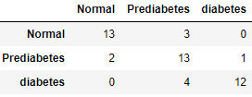
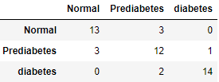
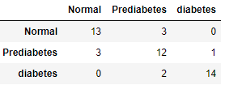
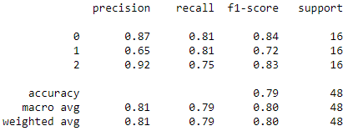
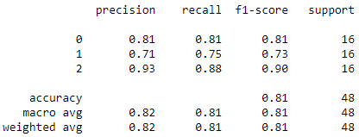
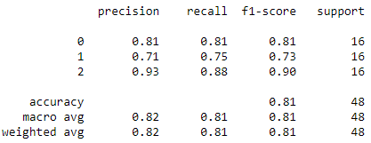
2. Test Set results
4 years training data with 12 feature set
Dataset distribution: [diabetes=76, prediabetes=1,400, Normal =2,314]
Training set size: 1,384 data points per class
Testing set size:16 data points per class
RF
Accuracy = 0.791
CV-Accuracy: 0.82 (+/- 0.02)
XGBoost
Accuracy = 0.812
CV-Accuracy: 0.81 (+/- 0.02)
SVM
Accuracy = 0.812
CV-Accuracy: 0.80 (+/- 0.02)

Slide 7
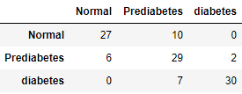
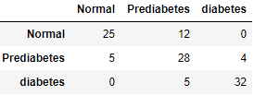
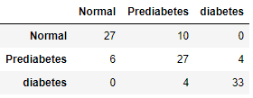
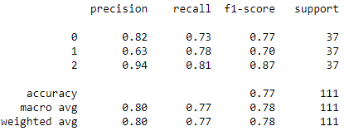
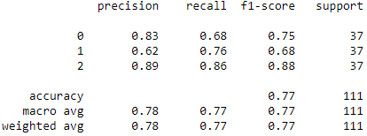
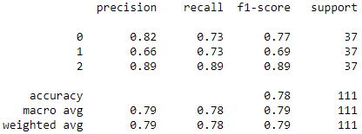
2. Test Set results
3 years training data with 12 feature set
Dataset distribution: [diabetes=184, prediabetes=3,245, Normal = 6,295]
Training set size: 3,195 data points per class
Testing set size: 50 data points per class
RF
Accuracy = 0.774
CV-Accuracy: 0.81 (+/- 0.01)
XGBoost
Accuracy = 0.765
CV-Accuracy: 0.80 (+/- 0.01)
SVM
Accuracy = 0.783
CV-Accuracy: 0.78 (+/- 0.01)

Slide 8
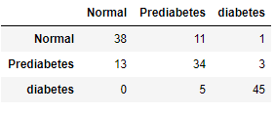
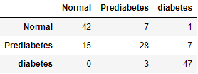
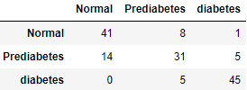
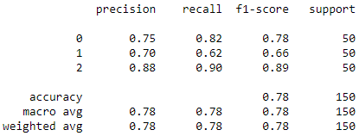
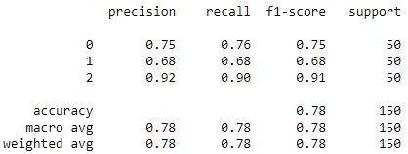
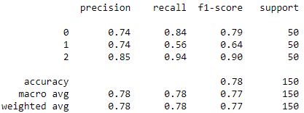
2. Test Set results
2 years training data with 12 feature set
Dataset distribution: [diabetes=436, prediabetes=7,452, Normal = 16,314]
Training set size: 7,402 data points per class
Testing set size: 50 data points per class
RF
Accuracy = 0.78
CV-Accuracy: 0.79 (+/- 0.01)
XGBoost
Accuracy = 0.78
CV-Accuracy: 0.78 (+/- 0.01)
SVC
Accuracy = 0.78
CV-Accuracy: 0.76 (+/- 0.01)

Slide 9
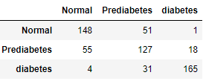
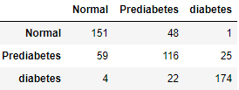
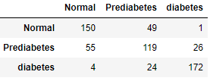
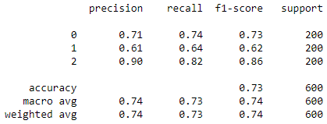
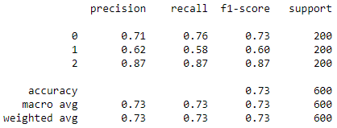
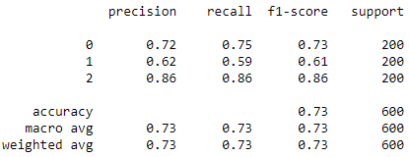
2. Test Set results
1 year training data with 12 feature set
Dataset distribution: [diabetes= 1,045, prediabetes= 17,331, Normal = 38,166]
Training set size: 17,131 data points per class
Testing set size: 200 data points per class
RF
Accuracy = 0.733
CV-Accuracy: 0.75 (+/- 0.04)
XGBoost
Accuracy = 0.735
CV-Accuracy: 0.71 (+/- 0.04)
SVC
Accuracy = 0.735
CV-Accuracy: 0.72 (+/- 0.03)

Slide 10
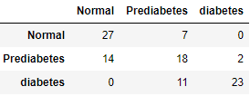
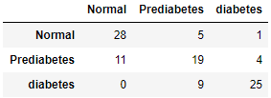
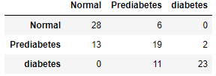
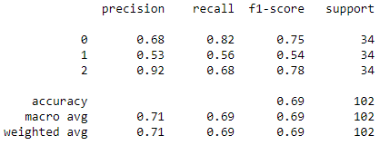
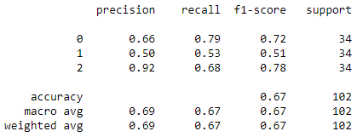
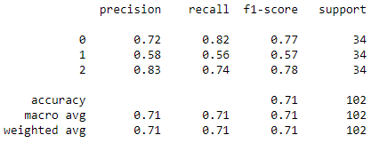
2. Test Set results
4 years training data with 5 feature set
Dataset distribution: [diabetes= 169, prediabetes= 2,349, Normal = 3,212]
Training set size: 2,349 data points per class
Testing set size: 34 data points per class
RF
Accuracy = 0.686
CV-Accuracy: 0.79 (+/- 0.05)
XGBoost
Accuracy = 0.666
CV-Accuracy: 0.75 (+/- 0.05)
SVM
Accuracy = 0.705
CV-Accuracy: 0.77 (+/- 0.03)

Slide 11
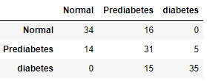
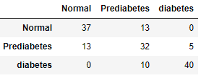
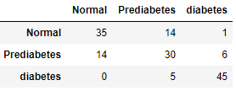
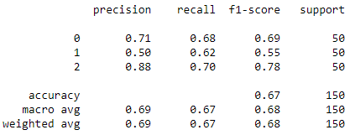
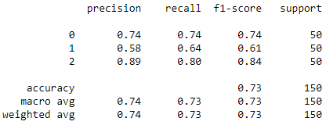
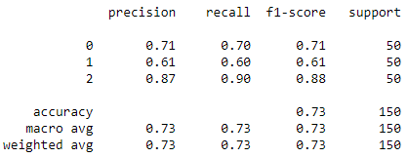
2. Test Set results
3 years training data with 5 feature set
Dataset distribution: [diabetes= 212, prediabetes=3,758, Normal = 6,888]
Training set size: 3,758 data points per class
Testing set size: 50 data points per class
RF
Accuracy = 0.666
CV-Accuracy: 0.78 (+/- 0.05)
XGBoost
Accuracy = 0.726
CV-Accuracy: 0.74 (+/- 0.05)
SVM
Accuracy = 0.733
CV-Accuracy: 0.75 (+/- 0.03)

Slide 12
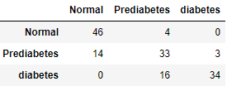
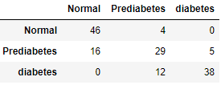
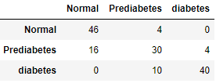
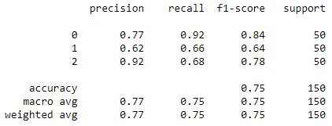
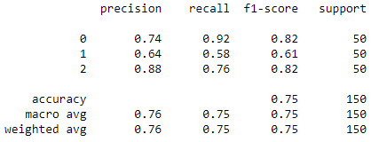
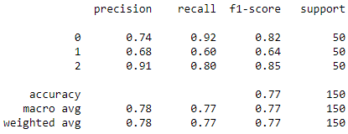
2. Test Set results
2 years training data with 5 feature set
Dataset distribution: [diabetes= 726, prediabetes= 10,492, Normal = 19,694]
Training set size: 10,492 data points per class
Testing set size: 200 data points per class
RF
Accuracy = 0.753
CV-Accuracy: 0.77 (+/- 0.05)
XGBoost
Accuracy = 0.753
CV-Accuracy: 0.73 (+/- 0.04)
SVC
Accuracy = 0.773
CV-Accuracy: 0.75 (+/- 0.03)

Slide 13
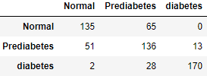
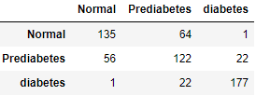
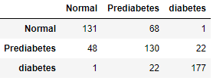
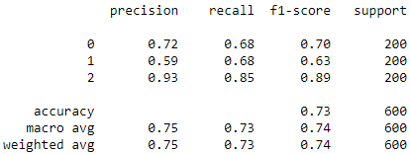
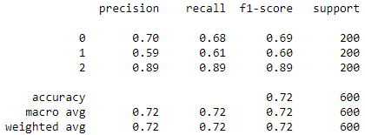
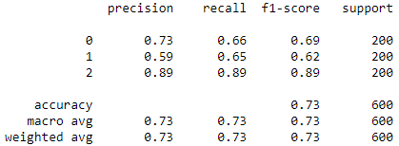
2. Test Set results
1 year training data with 12 feature set
Dataset distribution: [diabetes= 1,156, prediabetes= 18,708, Normal = 40,171]
Training set size: 18,708 data points per class
Testing set size: 200 data points per class
RF
Accuracy = 0.735
CV-Accuracy: 0.74 (+/- 0.04)
XGBoost
Accuracy = 0.723
CV-Accuracy: 0.70 (+/- 0.04)
SVM
Accuracy = 0.73
CV-Accuracy: 0.71 (+/- 0.02)

Slide 14
3. Remarks
As the number of years used to train the models increases the performance of the models tend to increase in both feature set based on the cross-validation results. However, if we look in detail for the 5 features set models, the performance shows a slight decline as the feature increase. Since cross-validation trains and tests on different datasets, it can be considered as a baseline performance measure as compared to the results on a single test set.
The performance of the models with 12 features set outperforms the traditional feature sets. Despite the difference in the number of features, we can generalize that the selected 12 features are good enough to be used as diabetes indicator variables and we can emphasize this result on the manuscript as a contribution.

